Slide 1
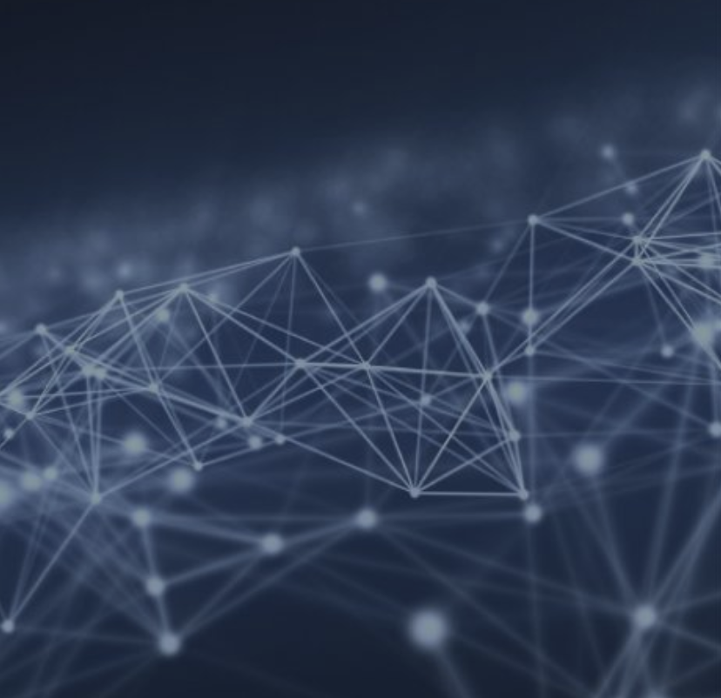
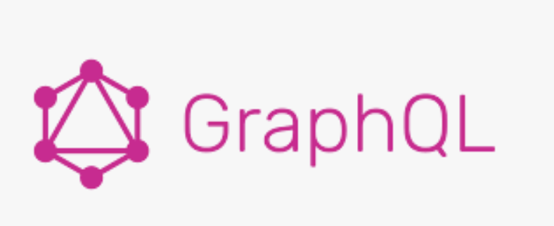
Graph Databases – Build Flexible Applications with Graph Data
March 2023 ( Deck Ver 2.1.5 - generic presentation )

Slide 2

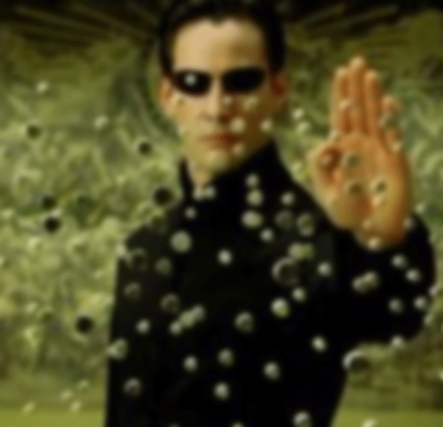
Graph
Points
Edges
Notes:
Real world data modelling
Botanist
Fast
In motions
Lots of it!!!

Slide 3
Graph
Points == Data
Edges between Points === Relationships
Notes:
Real world data modelling
Botanist
Fast
In motions
Lots of it!!!

Slide 4
Node relationships

Slide 5
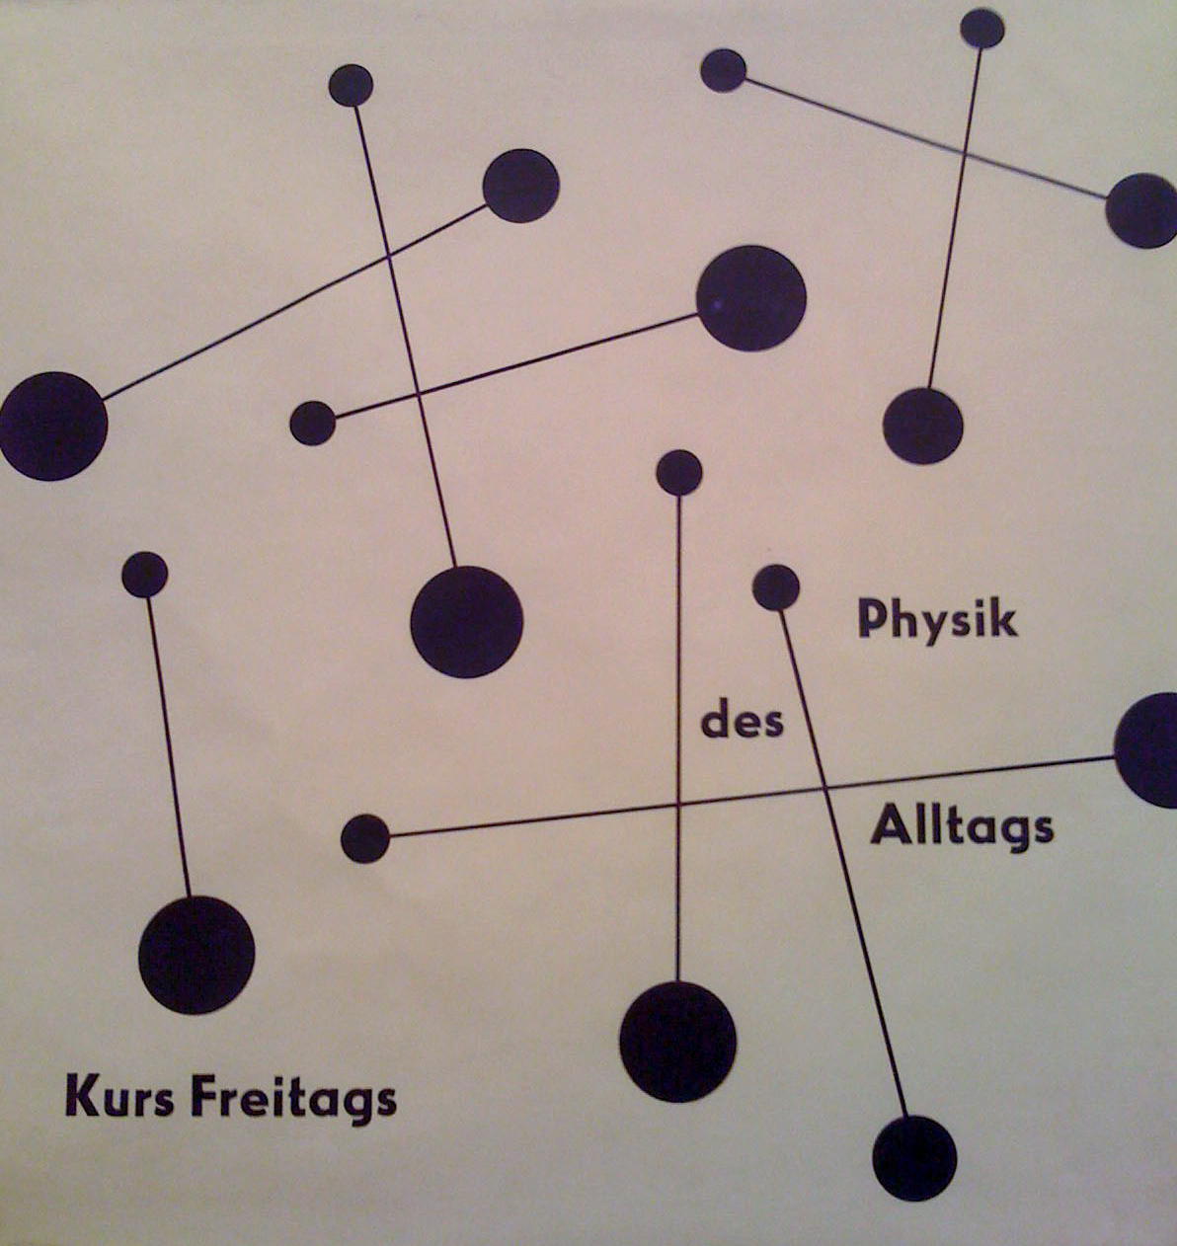
Node relations

Slide 6
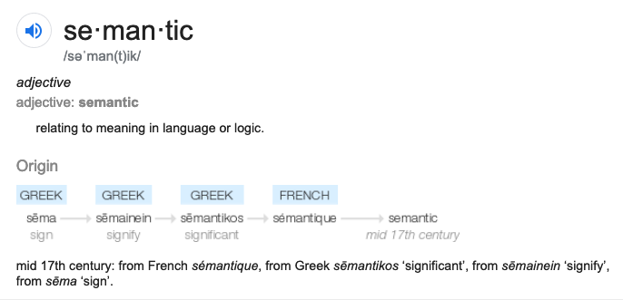
Semantic
MEANING | KNOWLEDGE

Slide 7
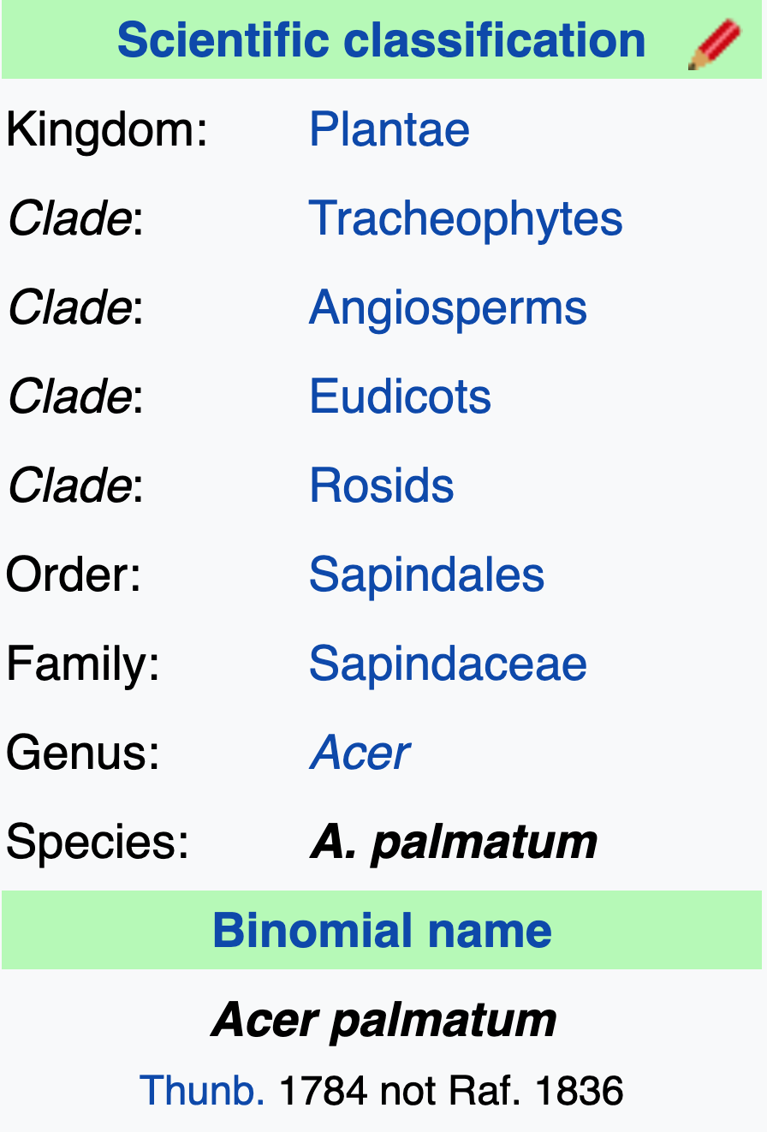

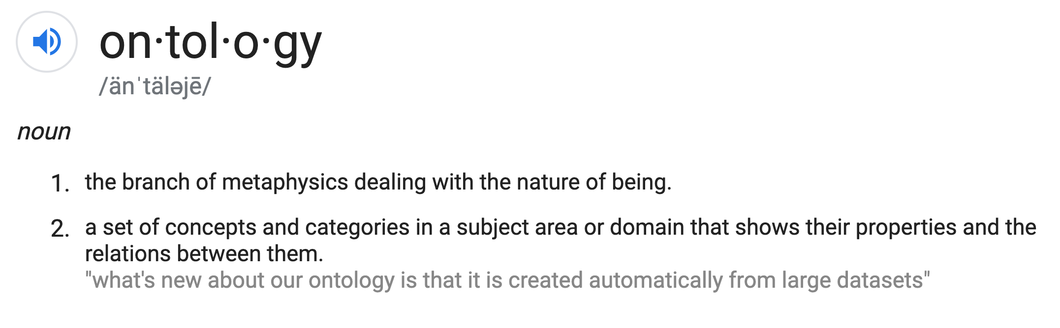
Ontology

Slide 8

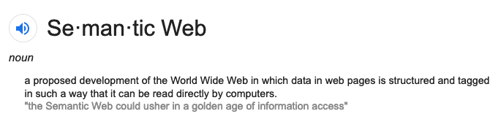
Golden age of Information Access

Slide 9
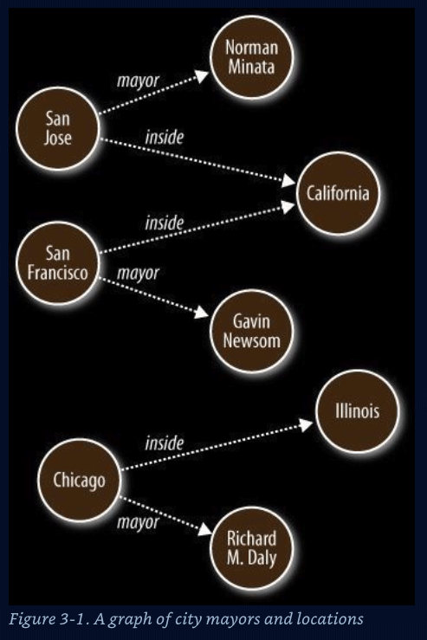
Vertices(data) and edges of a Semantic Graph
Nodes – Data Entities ( nouns )
S O
Edges – Relationships ( verbs )
P
Graph algorithms
Reasoning ( Decisions )
Inferences
Shortest path
Cliques / Neighborliness
Interconnected ness
Patterns
Notes:
Represent data that is hard to store in columnar and row format

Slide 10
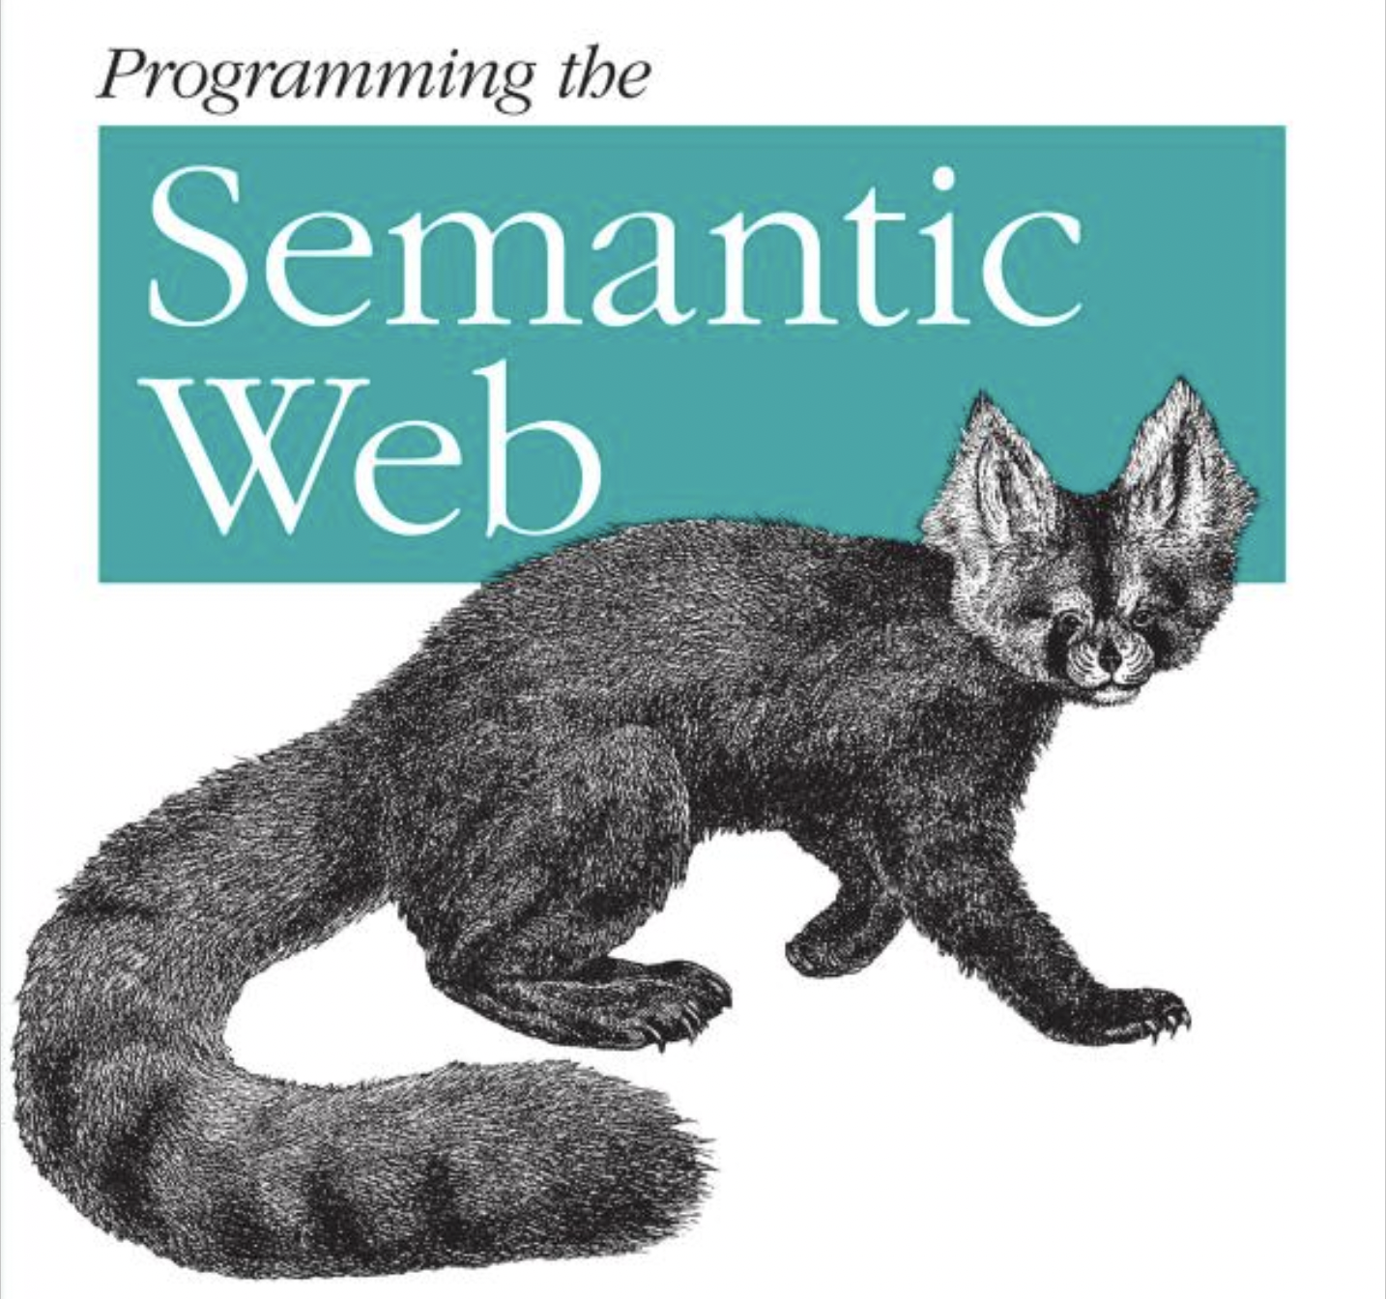
Seminal Text on the Semantic Web
Programming the Semantic Web: Build Flexible Applications with Graph Data 1st Edition ( Published, nearly 35 years ago, 2009)
Authors
Toby Segaran
Colin Evans
Jamie Taylor
Notes:
Semantic data can be used to Express Graph Data Structures in a Graph Database ( Semantic Datastore/Database )
August 21st 2009
2023 currently Wed Feb 22nd
2009 Pulished
------------------------------------------
0034 years ago

Slide 11
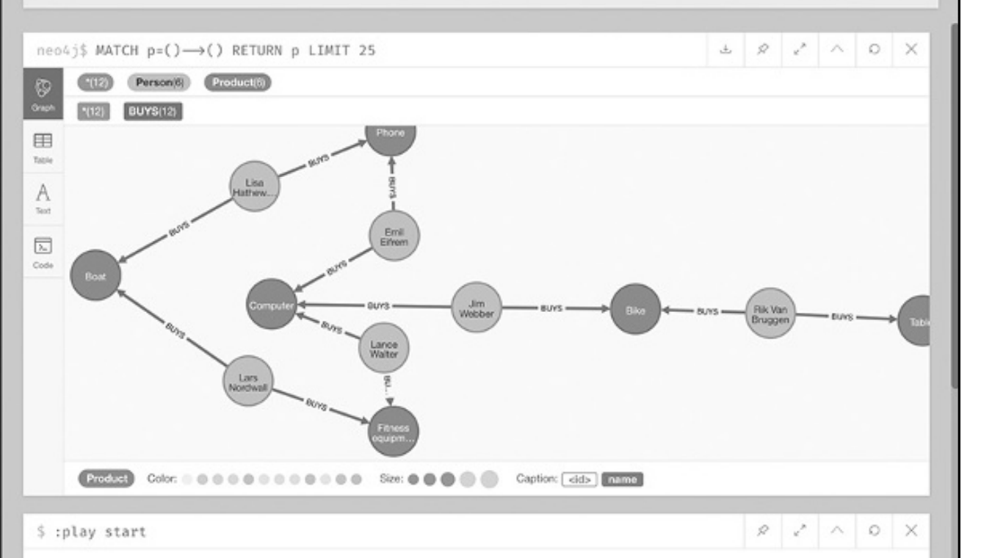

Who bought computers and bikes and phones
Notes:
A data structure to who bought what – Neo4j visual tool

Slide 12
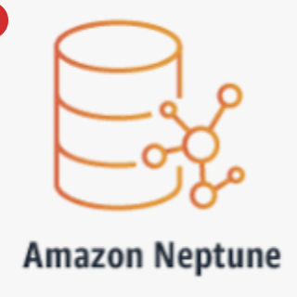
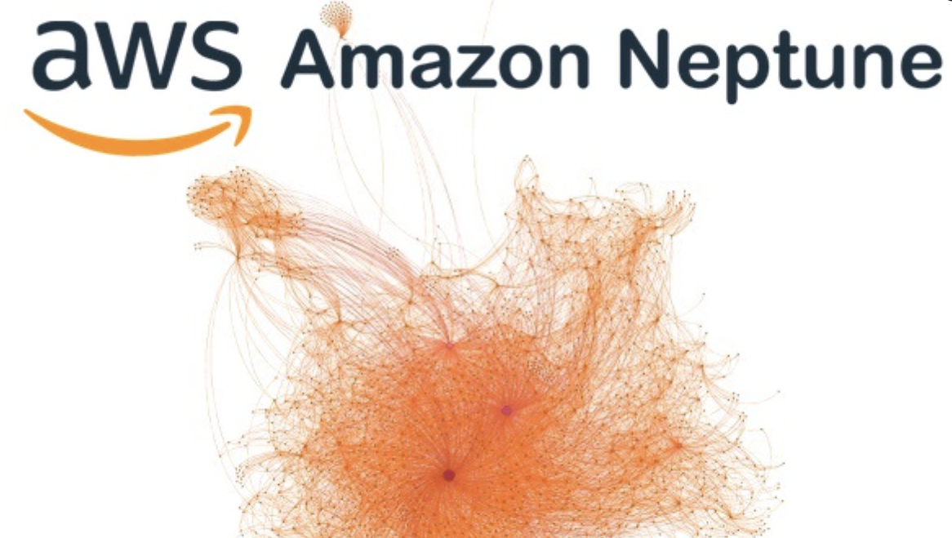
Amazon Graph Database offering in AWS Cloud

Slide 13
The World Wide Web
Resource Description Framework
Web model/standard for data interchange on the WWW
RDF has features that facilitate data merging even if the underlying schemas differ.
Supports `schema` evolution over time without requiring all the data consumers to be changed
Notes:
RDF – sums it up
Underpinnings of the www

Slide 14
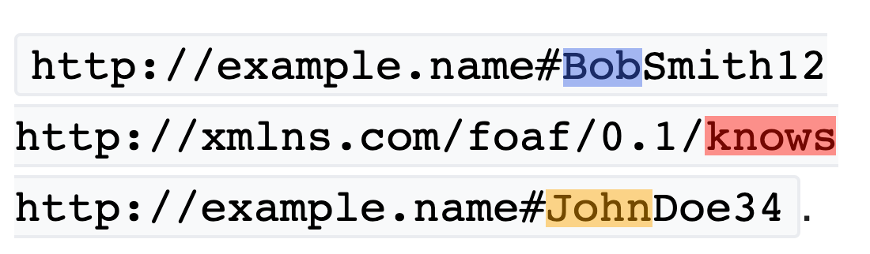
RDF Triples
SUBJECT
PREDICATE
OBJECT
Notes:
RDF extends the linking structure of the Web to use URIs to name the relationship between things as well as the two ends of the link

Slide 15
Why is Graph useful
Network of nodes | Veritices joined by edges | 3 types of edges Uni-directinal Bi-directional No-direction I Line | Describes Pathways, trees and DAG’s ( Directed Acyclic Graphs ) | Semantic native datatype is the Triple
Points of data | Related by edges |  |  | 3 parts
 |  |  |  | Subject
 |  |  |  | Predicate
 |  |  |  | Object
 |  |  |  | SPO
 |  |  |  | Example
 | Subject | Predicate | Object/Subject | Predicate
 | Kevin Bacon | Co-acted-with | Rugter Hauer | Professional_title
 |  |  | dated | Object
 |  |  | Rachel Welch | Actor

Slide 16
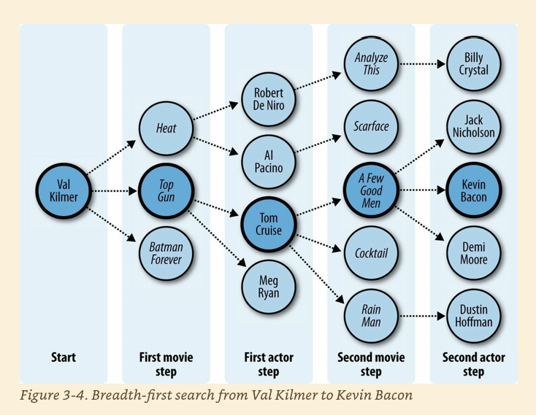
FOAF Six degrees of seperation
Notes:
﻿Six Degrees of Kevin Bacon A good example of the breadth-first search algorithm is the trivia game “Six Degrees of Kevin Bacon,” where one player names a film actor, and the other player tries to connect that actor to the actor Kevin Bacon through the shortest path of movies and co-stars. For instance, one answer for the actor Val Kilmer would be that Val Kilmer starred in Top Gun with Tom Cruise, and Tom Cruise starred in A Few Good Men with Kevin Bacon, giving a path of length 2 because two movies had to be traversed.
Evans, Colin. Programming the Semantic Web: Build Flexible Applications with Graph Data (p. 51). O'Reilly Media. Kindle Edition.

Slide 17
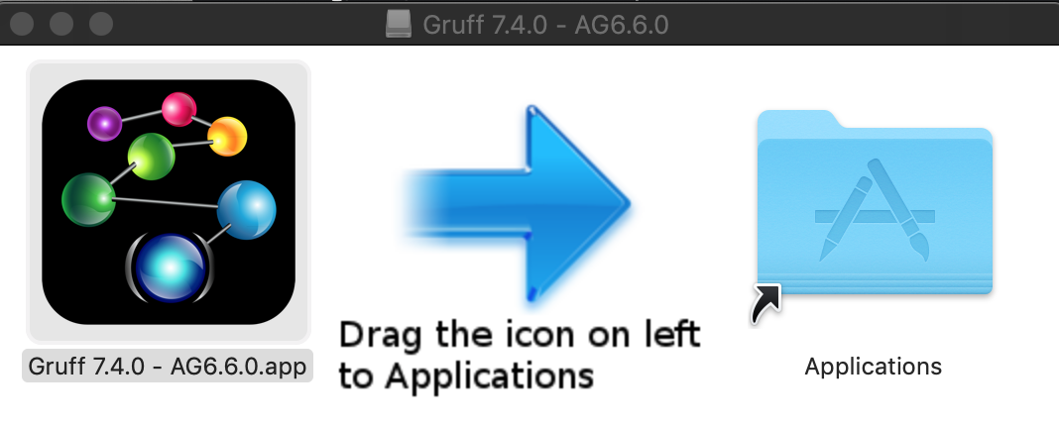
Demo Gruff
Notes:
Show pizza in Web View - Add Triples … then display sample nodes

Slide 18
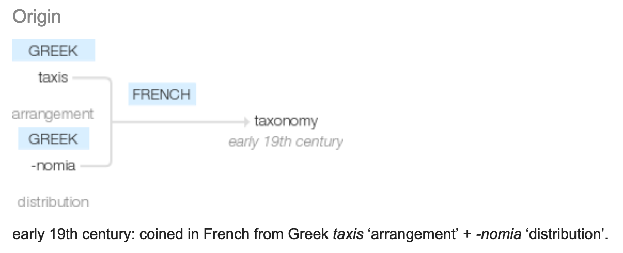
Taxonomy
Notes:
ONTOLOGY

Slide 19
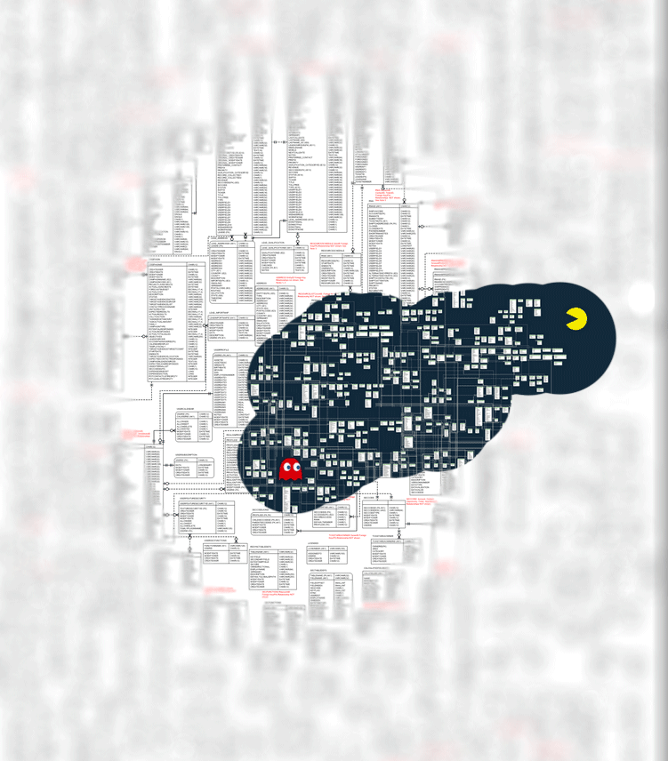
Inference New Ideas + Hypotheses Patterns
Notes:
LOOKING FOR
FINDING PATTERNS

Slide 20
Why?
Data
Volume huge
ETL
Retrieval / Query

Slide 21
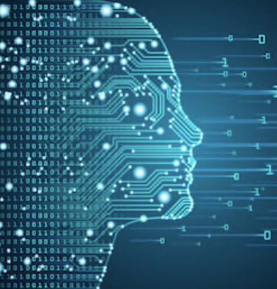
Web – worlds biggest `sensor`
Web pages – Human readable – unstructured
What is machine readable? – structured
Big Fast Moving Data – overwhelming TL;DR;
Notes:
How to Derive Structure from Unstructured Web
Google search – good for humans

Slide 22
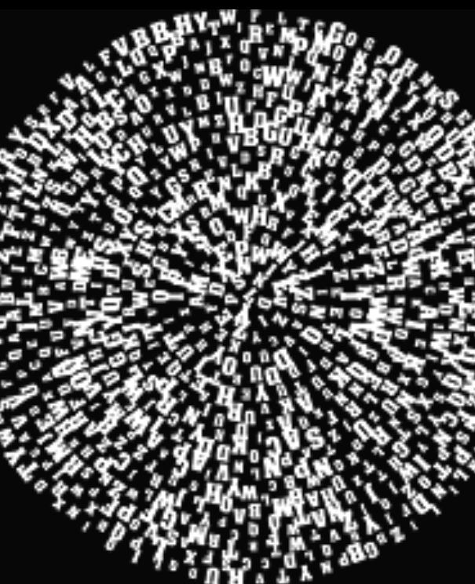
Triple `Soups`
Bowl -> Triple Store – Semantic Graph DB
`Alphabet soup` -> SPO OPS POS SOP POS
Merge ?
Notes:
Merge Using this simple model, it allows structured and semi-structured data to be mixed, exposed, and shared across different applications.

Slide 23
Flavors
N-Triples
RDF
aRDF

Slide 24
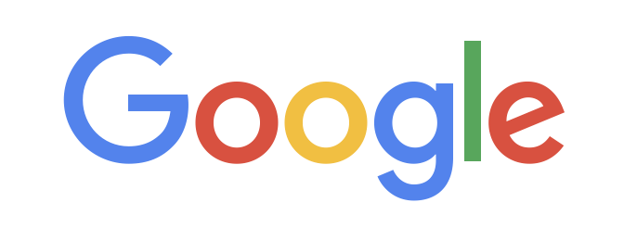
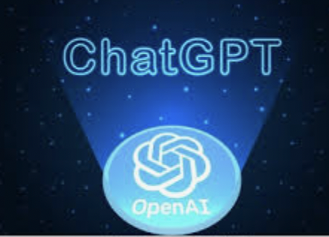
Semantic/Graph database top ranked
Neo4j
AmazonNeptune
AllegroGraph
Cosmos DB
"top 6 graph databases"
1. Neo4j
2. Amazon Neptune
3. OrientDB
4. ArangoDB
5. FlockDB
6. AllegroGraph
Notes:
Neo4j ( AWS Marketplace, SAAS Azure )
Amazon Neptune on AWS
Serverless graph database designed for superior scalability and availability
AllegroGraph – Docker standalone or VM image on all major Cloud offerings
Azure Cosmos DB for Apache Gremlin on Azure

Slide 25
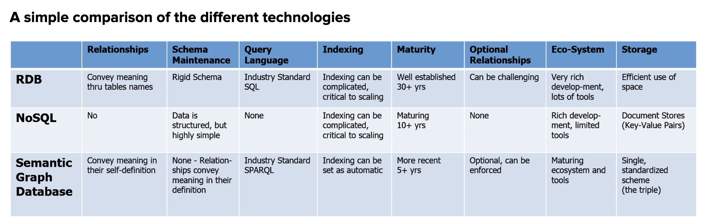
Comparison
RDBs ( MySQL, MSSQL, DB2 etc )
NoSQL ( CouchDB, MongoDB, DocumentDB, etc )
Semantic Graph DB ( Neo4j, allegroGraph(agraph) )
Notes:
How does Graph square up wrt Relational DBMS and / or NoSQL stores?

Slide 26

Overview
Unlike traditional relational databases or more recently developed NoSQL databases or simple property graphs,
Franz’s AllegroGraph employs a combination of semantic graph (RDF, OWL, SPARQL) and document (JSON, JSON-LD) technologies that process data with contextual and conceptual intelligence.
AllegroGraph with FedShard™ is able to run queries of unprecedented complexity to support predictive analytics that help companies make better, real-time decisions.
AllegroGraph is designed to integrate with large corporate databases to build Knowledge Graphs for better business insights.

Slide 27
Popular Use Cases
Social Networks - FOAF
Bio-Informatics
Music
Portfolio Analysis
Fraud detection – AML
…
Financial/Banking industry use cases
Notes:
Dodd-Frank Wall Street Reform
Mortgage and Loan rules and auditability of transactions
Credit Default Swaps ownership reporting
Know Your Customer requirements
Sarbanes-Oxley
Business and Legal Entity tracking requirements
Computation of derivatives risk
Basal III international regulations
Foreign corrupt Practices Act
UK Bribery Act
Fraud Detection
Personal Information security
New regulations on transfer pricing

Slide 28
3rd Party Integration
Cloudera
Anaconda
ML/Data mining
NoSQL Ecosystem
MongoDB integration
Solr Text indexing
Financial/Banking industry use cases
Notes:
Dodd-Frank Wall Street Reform
Mortgage and Loan rules and auditability of transactions
Credit Default Swaps ownership reporting
Know Your Customer requirements
Sarbanes-Oxley
Business and Legal Entity tracking requirements
Computation of derivatives risk
Basal III international regulations
Foreign corrupt Practices Act
UK Bribery Act
Fraud Detection
Personal Information security
New regulations on transfer pricing

Slide 29
Use cases for semantic / graph
Social Networks - FOAF
Bio-Informatics
Music
Portfolio Analysis
Fraud detection – AML
Notes:
AML anti money laudering – human trafficking, illegal arms dealers,

Slide 30
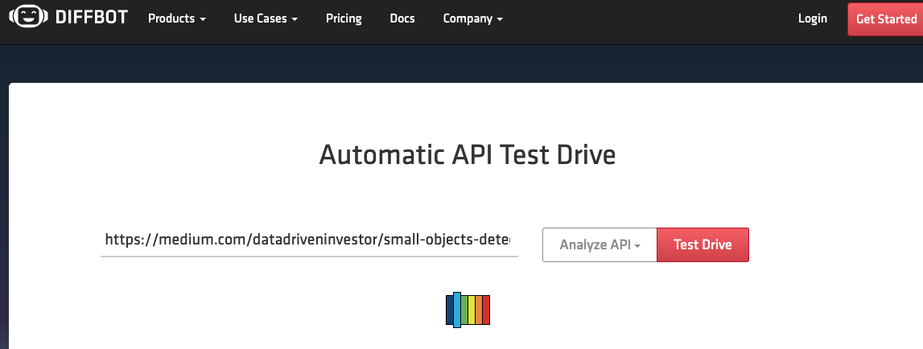
Extraction – demo 1

Slide 31
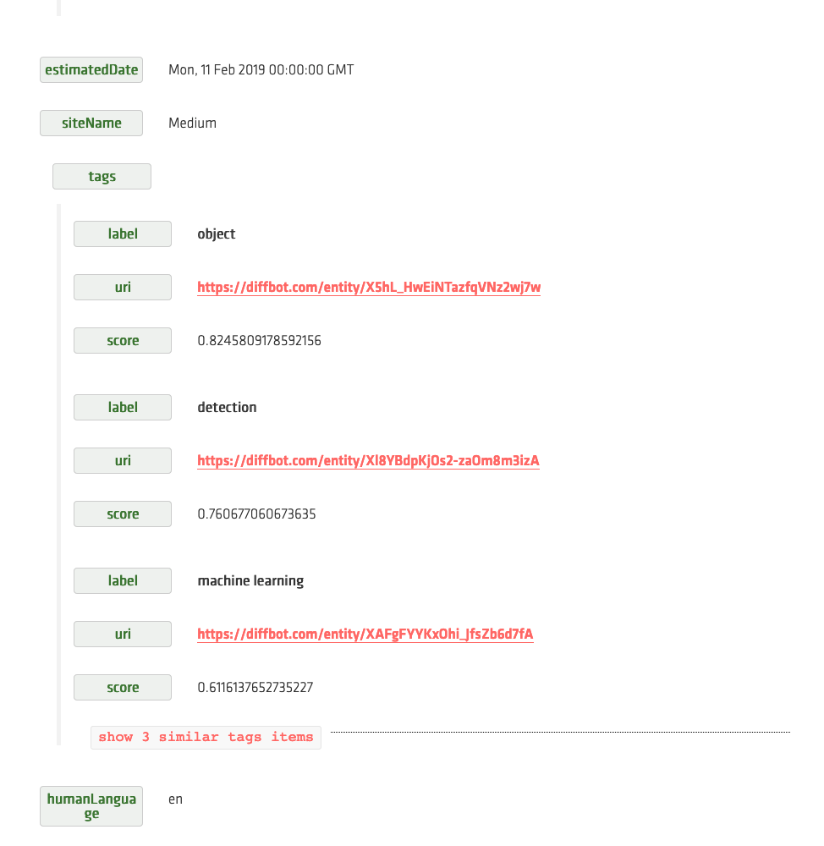
Extraction

Slide 32
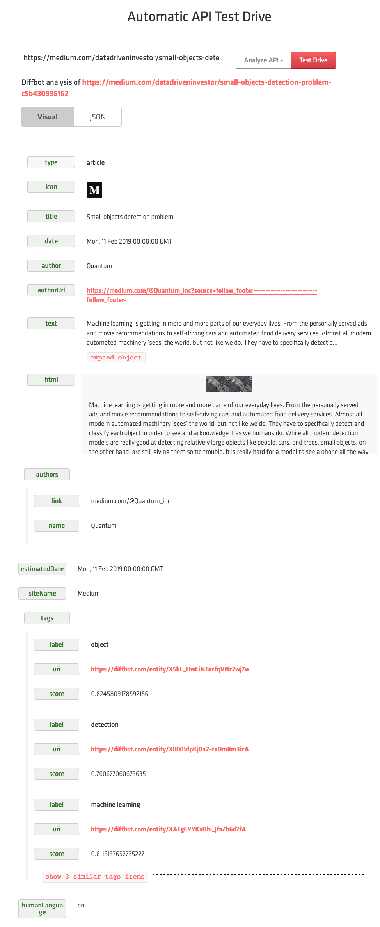

Slide 33
Docker version of Agraph https://franz.com/agraph/docker/

Slide 34
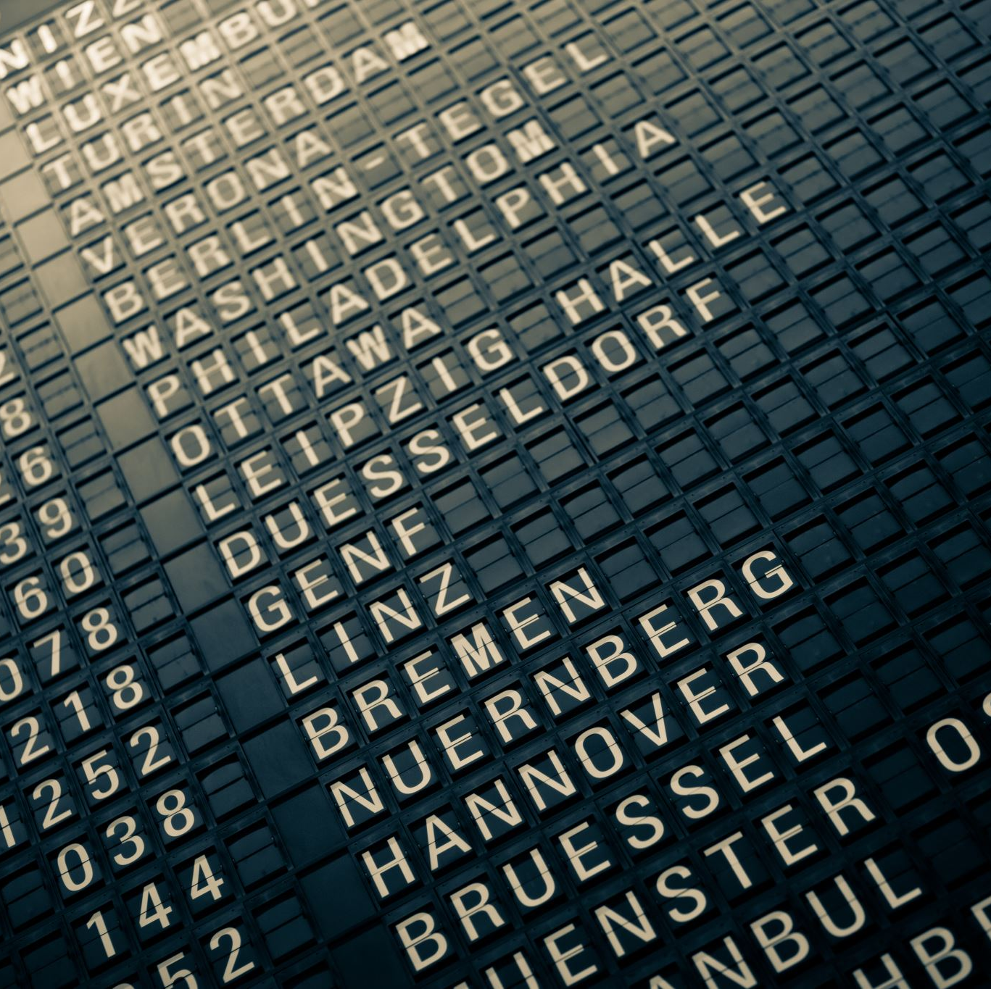

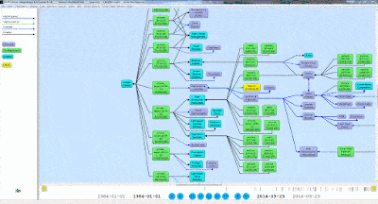
Thank you!!
https://github.com/Grant-Steinfeld

Slide 36


Q&A
Thanks for joining
Grant.Steinfeld@Prudential.com
https://github.com/Grant-Steinfeld

Slide 37
Seminal Text on the Semantic Web
Programming the Semantic Web: Build Flexible Applications with Graph Data 1st Edition ( Published, nearly 35 years ago, 2009)
Authors
Toby Segaran
Colin Evans
Jamie Taylor
Build
flexible
Applications with
Semantic data,
Expressed as a Graph Data
Notes:
Semantic data can be used to Express Graph DataStructures in a Graph Database ( Semantic Datastore/Database )
August 21st 2009
2023 currently Wed Feb 22nd
2009 Pulished
------------------------------------------
0034 years ago

Slide 38
Resources
Evans, Colin. Programming the Semantic Web: Build Flexible Applications with Graph Data ( book on Amazon )
AllegroGraph (agraph) DB homepage, Franz Inc. https://franz.com/
N-TRIPLES spec - http://www.w3.org/TR/rdf-testcases/#ntriples.
Blog - Ontology and Data Science - Favio Vaquez

Slide 39
Resources (2)
Semantic Graphs: What they are and Why You Should Care ( Blog by David Vandegrift )
DBpedia Global and Unified Access to Knowledge Graphs ( core engine Wikipedia )
Wikimedia / Commons
Schema.org – discover common and standard labels (Predicates (P))

Slide 40
Resources (3)
Ontology Completion with Graph-Based Machine Learning: A Comprehensive Evaluation (Journal article, December 2022 by Sebastian Mežnar and others )
Semantic similarity and machine learning with ontologies ( Journal article 13 October 2020 by Maxat Kulmanov, Fatima Zohra Smaili, Xin Gao, Robert Hoehndorf)
Briefings in Bioinformatics, Volume 22, Issue 4, July 2021, bbaa199, https://doi.org/10.1093/bib/bbaa199
AWS Neptune – The Good, The Bad, and the Ugly

